Slide 1
Computer Organization and Design Transistors & Logic - II
Montek Singh
Mar 30, 2016
Lecture 10

Slide 2
Today’s Topics
Basic gates
Boolean algebra
Synthesis using standard gates
Truth tables
Universal gates: NAND and NOR
Gates with more than 2 inputs
Sum-of-Products
DeMorgan’s Law

Slide 3
Single-Input Logic Gates

Slide 4
Two-Input Logic Gates

Slide 5
More Two-Input Logic Gates

Slide 6
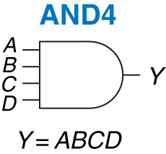
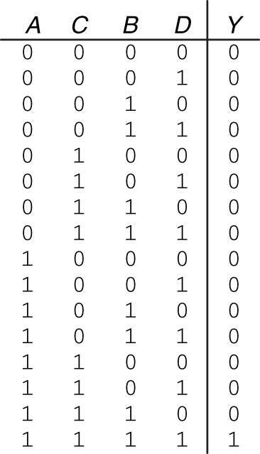
Multiple-Input Logic Gates

Slide 7
Multiple-Input Logic Gates

Slide 8
Boolean Algebra
Algebra of 1s and 0s

Slide 9
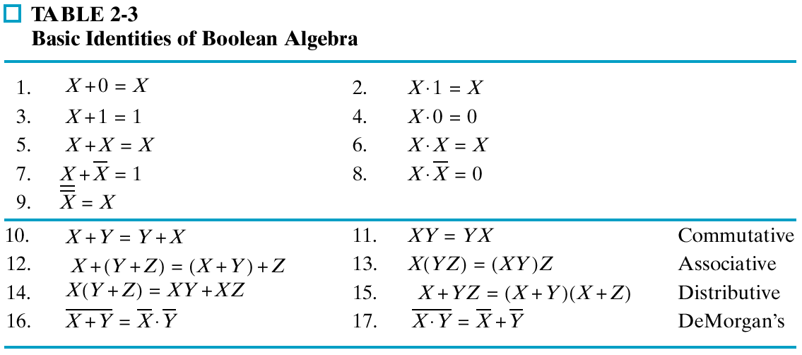
Table of Identities

Slide 10
Duals
Left and right columns are duals
Replace ANDs and ORs, 0s and 1s

Slide 11
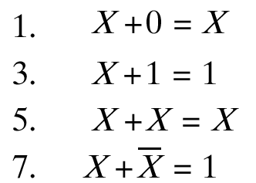
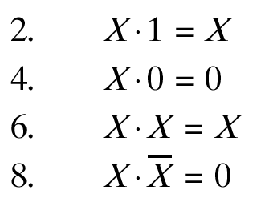

Single Variable Identities

Slide 12


Commutativity
Operation is independent of order of variables

Slide 13

Associativity
Independent of order in which we group
So can also be written as and

Slide 14
Distributivity

Slide 15
Substitution
Can substitute arbitrarily large algebraic expressions for the variables
Distribute an operation over the entire expression
Example:
X + YZ = (X+Y)(X+Z)
Substitute ABC for X
ABC + YZ = (ABC + Y)(ABC + Z)

Slide 16


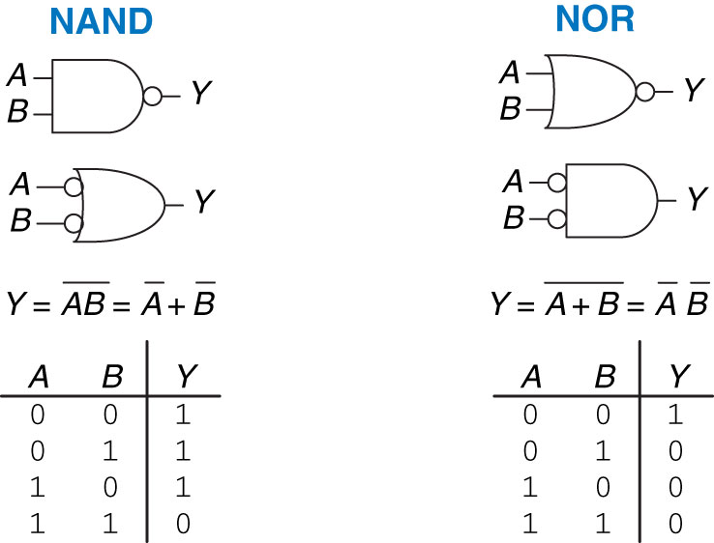
DeMorgan’s Theorem
Used a lot
NOR ➔ invert, then AND
NAND ➔ invert, then OR
Notes:
Interting a NOR to an AND
Inverting a NAND to a OR

Slide 17
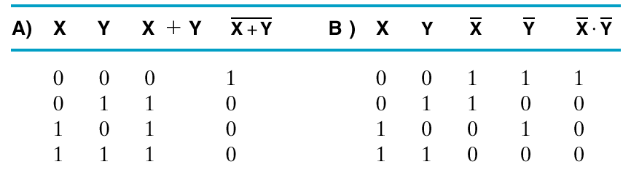

Truth Tables for DeMorgan’s

Slide 18
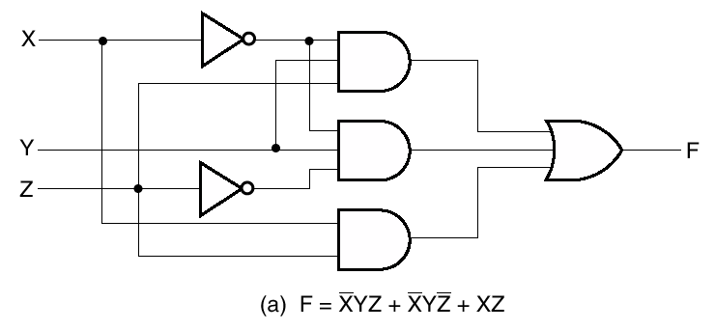
Algebraic/Boolean Manipulation
Apply algebraic and Boolean identities to simplify expression
Example:

Slide 19


Simplification Example
Apply
Apply
Apply

Slide 20
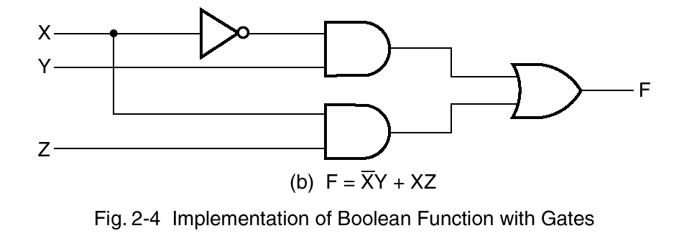

Fewer Gates

Slide 21
From Truth Table to Gate-Level Circuit

Slide 22
Now We’re Ready to Design Stuff!
We need to start somewhere
usually it’s the functional specification
A
If C is 1 then copy B to Y, otherwise copy A to Y
Y
B
Truth Table
C
First step is to translate a verbal description into a tabular form. Any combinational function can be represented as a “truth table.”
A truth table lists the output(s) for each combination of inputs.

Slide 23
We Can Make Most Gates Out of Others
Example 1: B > A
Output Y is 1 if and only if B is 1 AND A is 0
➔ Y = B AND (NOT(A))
B>A
A
y
B

Slide 24
We Can Make Most Gates Out of Others
Example 2: A XOR B
Output Y is 1 if and only if …
B is 1 AND A is 0 --OR—
B is 0 AND A is 1
➔ Y = B AND (NOT(A)) OR A AND (NOT(B))
XOR
A
B
Y
A
Y
B
Symbol for XOR

Slide 25
How many gates do we really need?

Slide 26
One Will Do!
NANDs and NORs are universal
one can make any circuit out of just NANDs, or out of just NORs!
Ah! But what if we want more than 2-inputs?
=
=
=
=
=
=

Slide 27
Gate Trees: Multi-input gates
Suppose we have some 2-input XOR gates:
(same idea holds for AND and OR gates)
A
0
0
1
1
B
0
1
0
1
C
0
1
1
0
t_{pd} = 1
(latency)
And we want an N-input XOR:
XOR(A₁, A₂, A₃ … A_{N})
=XOR … (XOR(XOR(A₁, A₂), A₃) … A_{N})
output = 1 iff number of 1s
in input is ODD
(“ODD PARITY”)
N
t_{pd} (latency)= O( ___ ) in the WORST CASE.
Can we compute N-input XOR faster?
Notes:
DIFFERENT prop delays from each INPUT...
... but we’re taking MAX (worst case).

Slide 28
Gate Trees
log₂N
2²
2¹
2
log N
N-input TREE has O( ______ ) levels...
Input→Output propagation takes O( _______ ) gate delays.
log N
Notes:
log N
log N
2^{k} inputs
for k levels.
2^{k} inputs for k levels

Slide 29
Design Approach: Sum-of-Products
Three steps:
Write functional spec as a truth table
Write down a Boolean expression for every ‘1’ in the output
Wire up the gates!
This approach will always give us logic expressions in a particular form:
SUM-OF-PRODUCTS (“SOP”)
“SUM” actually means OR
“PRODUCT” actually means AND
Truth Table

Slide 30
Straightforward Synthesis
We can implement SUM-OF-PRODUCTS…
…with just three levels of logic:
INVERTERS/AND/OR
A
B
C
A
B
C
Y
A
B
C
A
B
C

Slide 31
Notations
Symbols and Boolean operators:

Slide 32
DeMorgan’s Laws
Change ANDs into ORs and vice-versa

Slide 33
Useful Gate Structures
NAND-NAND
NOR-NOR
AB=A+B
“Pushing Bubbles”
C
C
C
≡
A
A
A
Y
Y
Y
B
B
B
DeMorgan’s Laws
AB=A+B
C
C
C
A
≡
A
A
Y
Y
Y
B
B
B

Slide 34
An Interesting 3-Input Gate: Multiplexer
Based on C, select the A or B input to be copied to the output Y.
Truth Table
A
If C is 1 then copy B to Y, otherwise copy A to Y
Y
B
C
2-input Multiplexer
A
0
B
1
Gate
symbol
C

Slide 35
Multiplexer (MUX) Shortcuts
A 4-bit wide 2-input Mux
A 4-input Mux (implemented as a tree)
A₀
B₀
A₁
B₁
0
1
Y₀
0
1_{S}
I₀
I₁
I₂
I₃
0
1
0
1
0
1_{S}
0
1_{S}
Y₁
0
1
A
B
C
D
S
0
1_{S}
Y
0
1
2
3
A₀₋₃
B₀₋₃
S
Y
A₂
B₂
A₃
B₃
Y₀₋₃
0
1
0
1
0
1_{S}
0
1_{S}
Y₂
0
1
0
1_{S}
Y₃
S₀ S₁
S

Slide 36
Next Class
Arithmetic circuits

